Slide 1
Q&A Chatbot for Public Datasets
Naomie Marciano

Slide 2
Table of contents
01
02
03
04
My Project
Steps
Technologies
Output

Slide 3
01
My Project

Slide 4
My Project
The goal of this project is to create an interactive data exploration and question-answering tool that allows users to easily retrieve and analyze GDP, life expectancy, and literacy rate data for countries worldwide.
It combines:
Automated data retrieval from the World Bank API
Natural language question parsing for quick answers
Statistical analysis and forecasting for deeper insights
Interactive visualizations to explore historical trends
The system aims to make global socio-economic data more accessible, helping students, researchers, and analysts quickly obtain insights without manually processing datasets.

Slide 5
02
Steps

Slide 6
Data
Data Retrieval
Fetch GDP, life expectancy, and literacy rate datasets from the World Bank API.
Optionally use cached data from SQLite to speed up future loads.
Data Cleaning & Normalization
Keep only relevant columns (country, ISO code, year, indicator, value).
Standardize metric names and convert values to numeric format.
Merge all metrics into a single dataset.

Slide 7
3) Local Storage
Save the merged dataset into a SQLite database (public_data.db) for reuse.
4) Question Parsing
Detect the metric, country, and year from natural language queries.
Support simple queries like "GDP of France in 2020".

Slide 8
5) Answer Retrieval
Try to get the data from the local dataset.
If missing, query the World Bank API live.
If still missing, optionally fall back to a Puppeteer-based web search.
6) Analytics & Statistics
Calculate descriptive statistics.
Perform correlation analysis between two metrics.
Run t-tests to compare metrics between countries.

Slide 9
8) Visualization
Generate time series plots for the chosen metric and country.
Allow filtering by start and end year.
9) User Interface
Build a Gradio web app with:
Ask Mode: Free-text Q&A
Explore Mode: Charts, stats, and forecasts.

Slide 10
03
Technologies

Slide 11
Technologies
Programming Language
Python 3 – Core language for all logic and data processing.
Data Retrieval & APIs
World Bank API – Source for GDP, life expectancy, and literacy rate datasets.
Requests – To fetch data from APIs.
Data Processing & Storage
Pandas – Data cleaning, merging, and analysis.
NumPy – Numerical computations.
SQLite3 – Local storage of cleaned datasets.

Slide 12
Technologies-Suite
Statistical Analysis & Forecasting
SciPy – Statistical tests (t-test, correlation).
Scikit-learn – Linear regression forecasting.
Visualization
Matplotlib – Time series and metric trend plots.
Natural Language Processing
Custom Parser – Extract metric, country, and year from user questions.
User Interface
Gradio – Web interface for Q&A and data exploration.
Optional Fallback Search
Puppeteer – Web automation (used if data is missing locally & from API).

Slide 13
04
Output

Slide 14
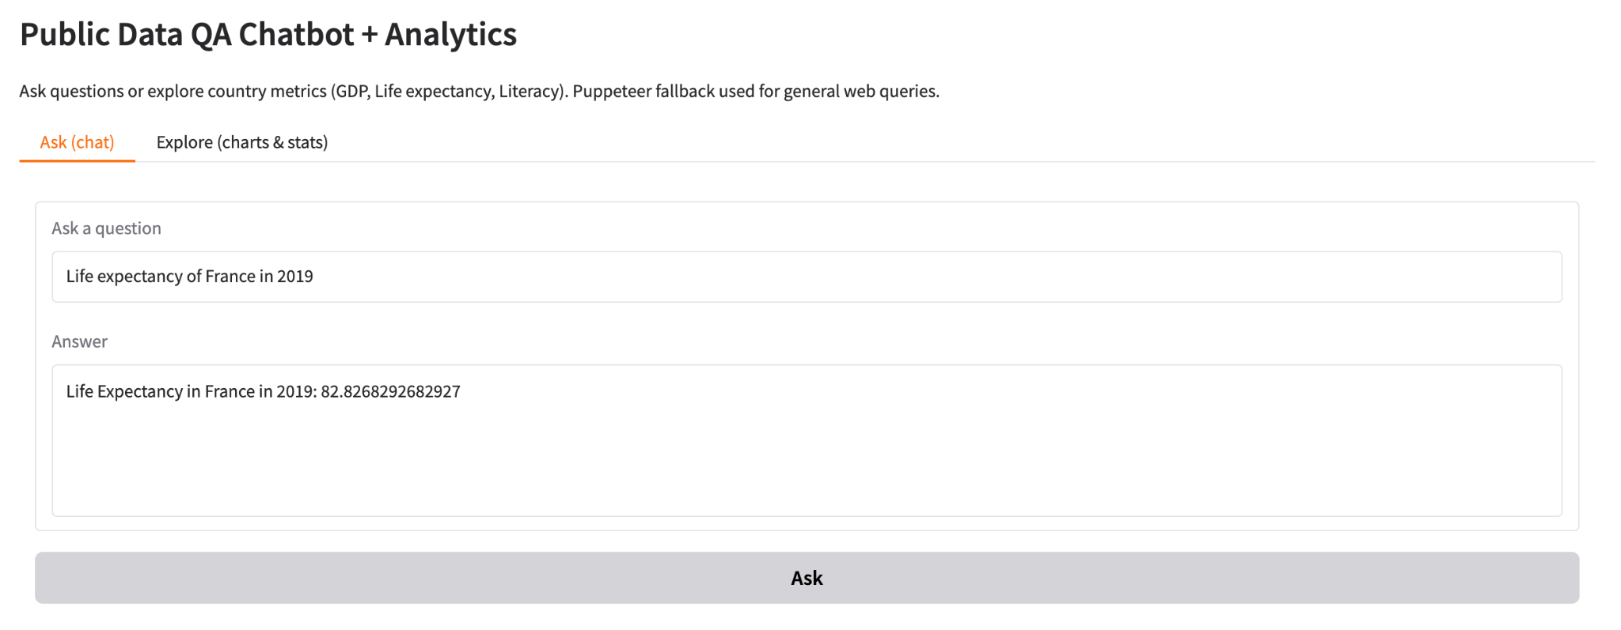
Q&A with our data

Slide 15
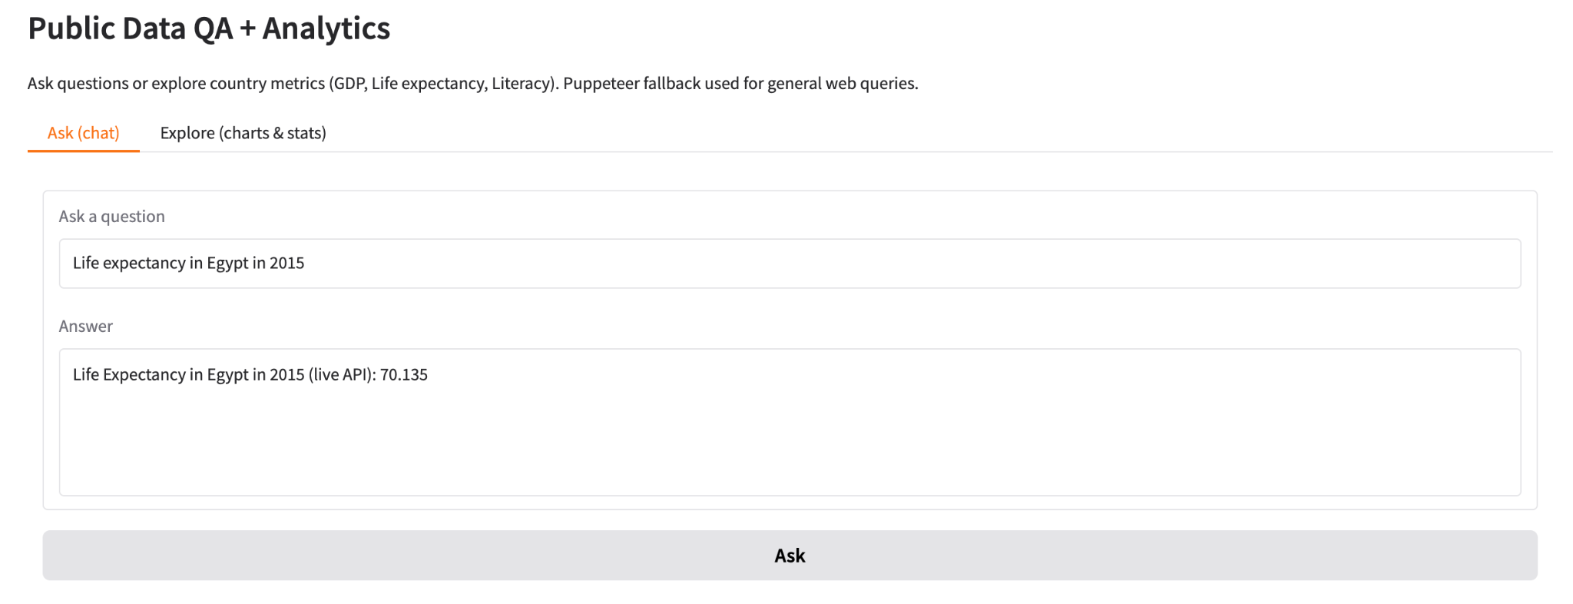
Q&A with Live API

Slide 16
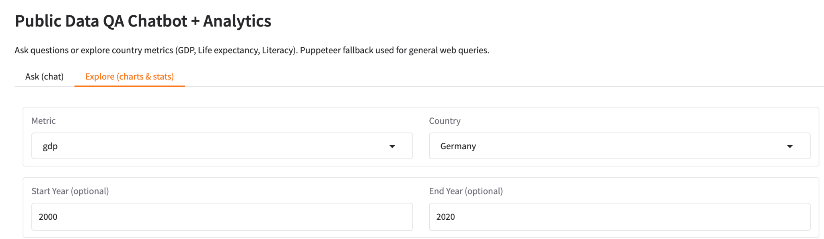
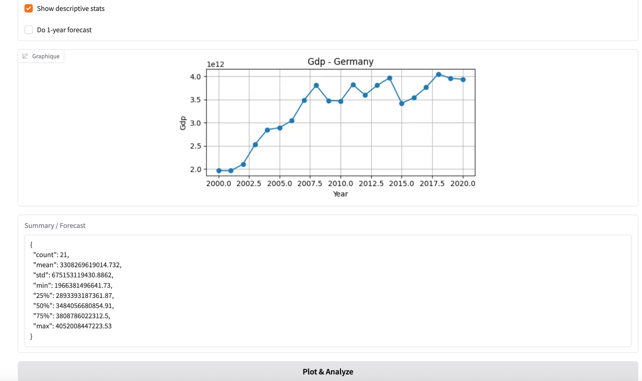

Slide 17
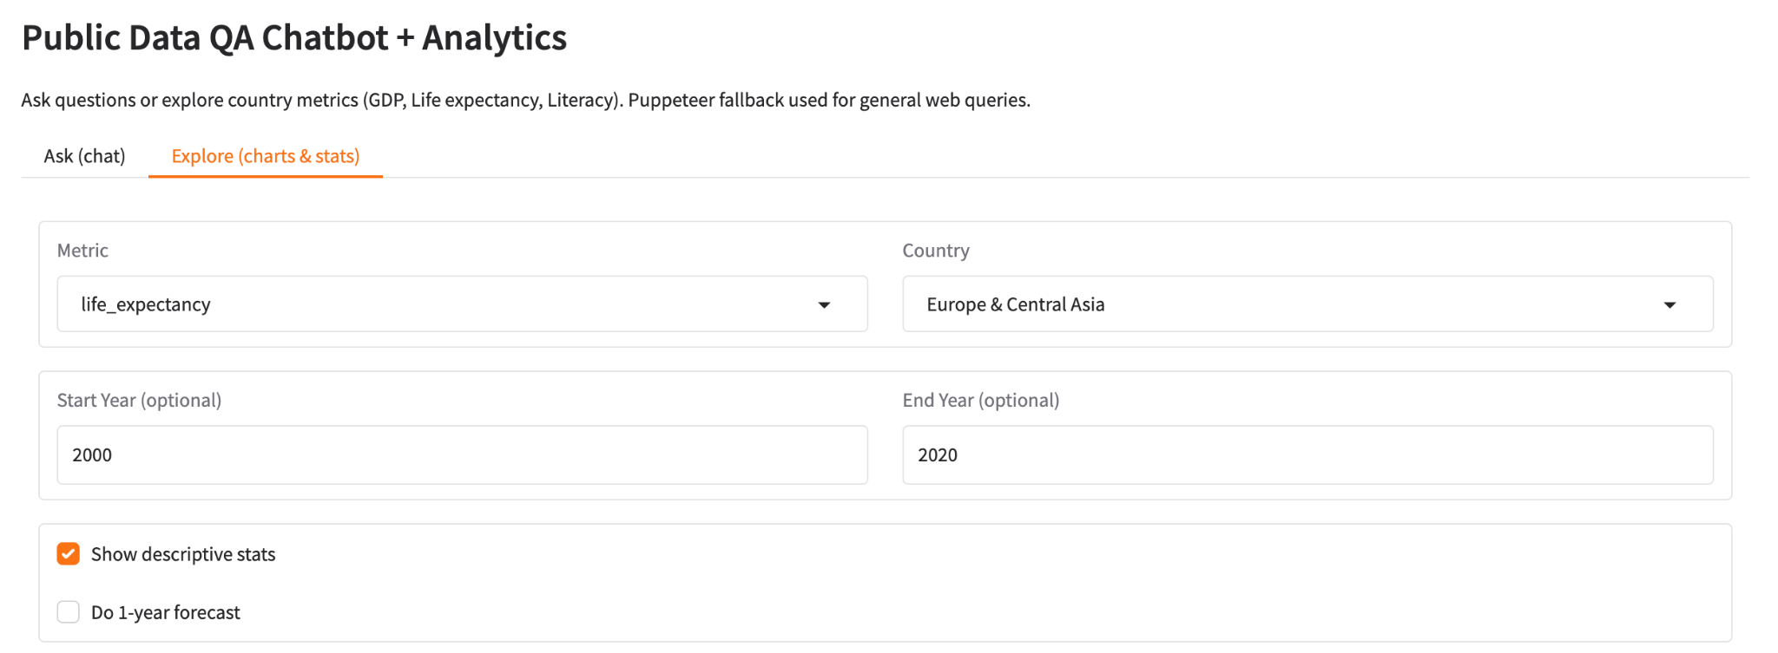
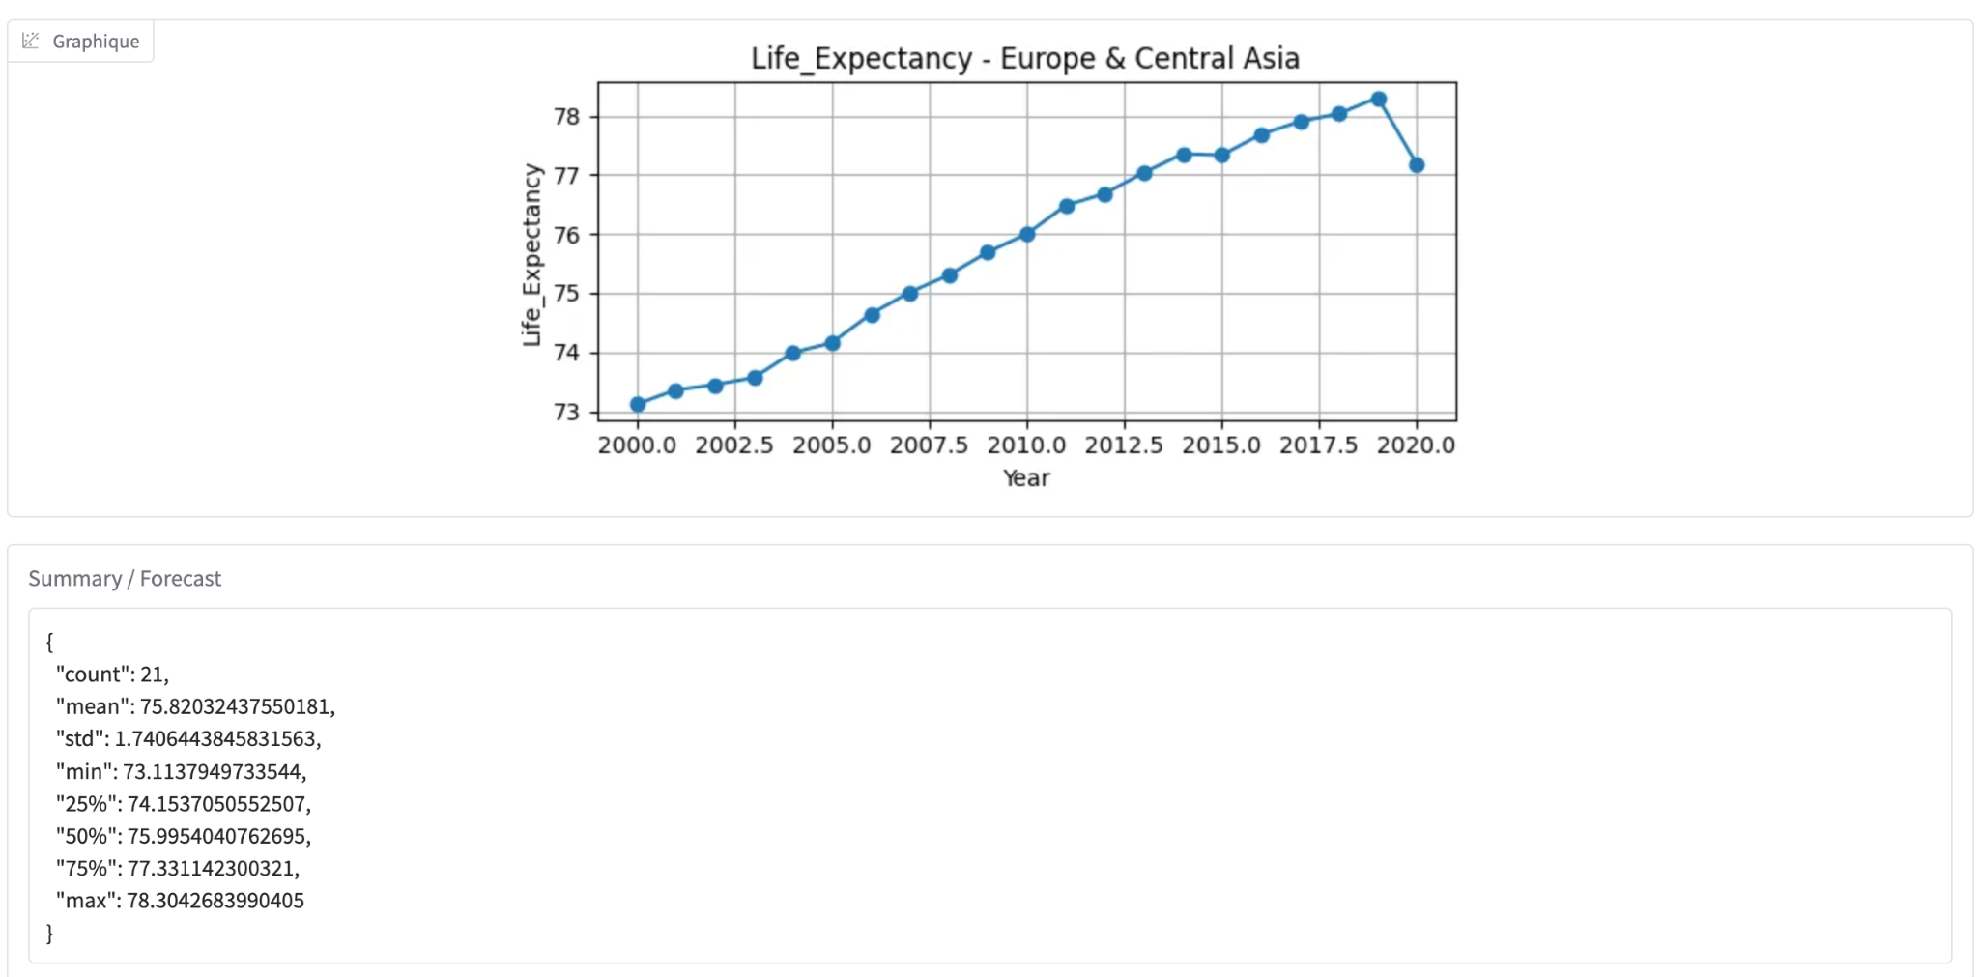

Slide 18
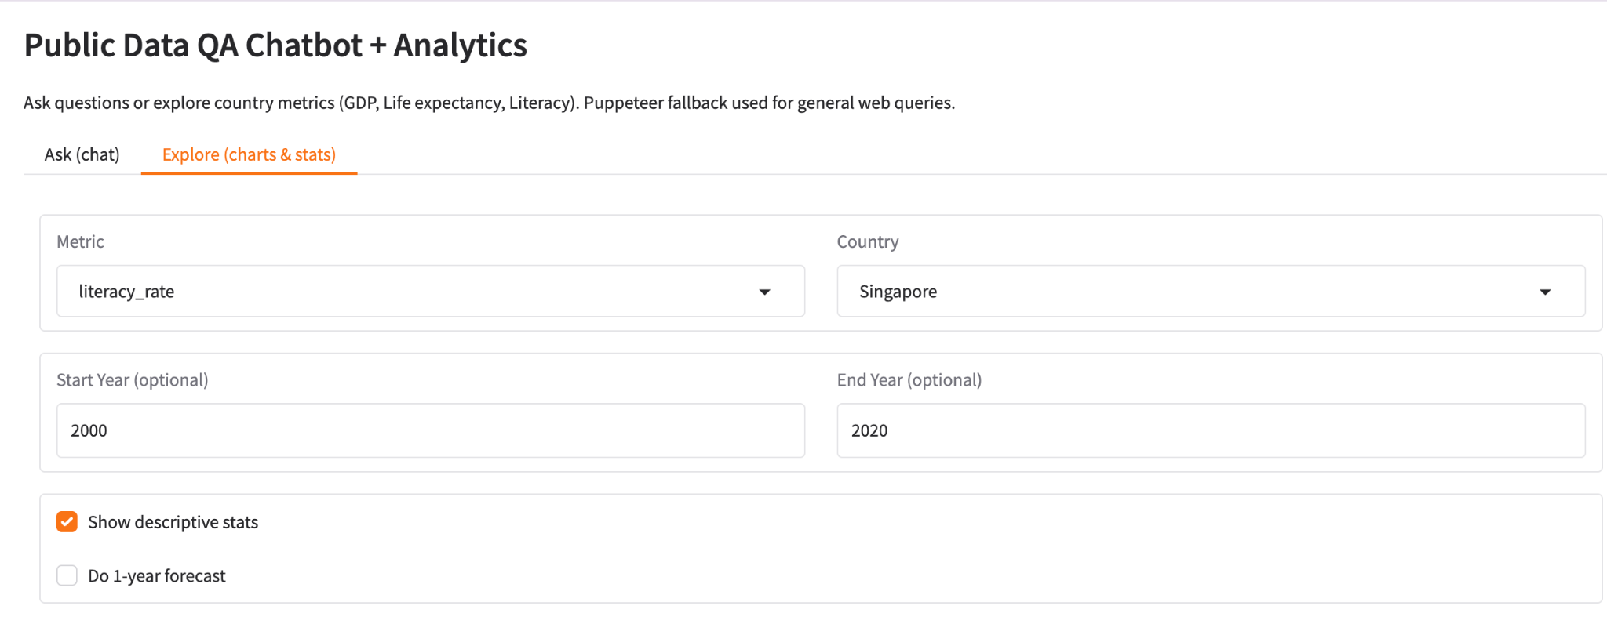
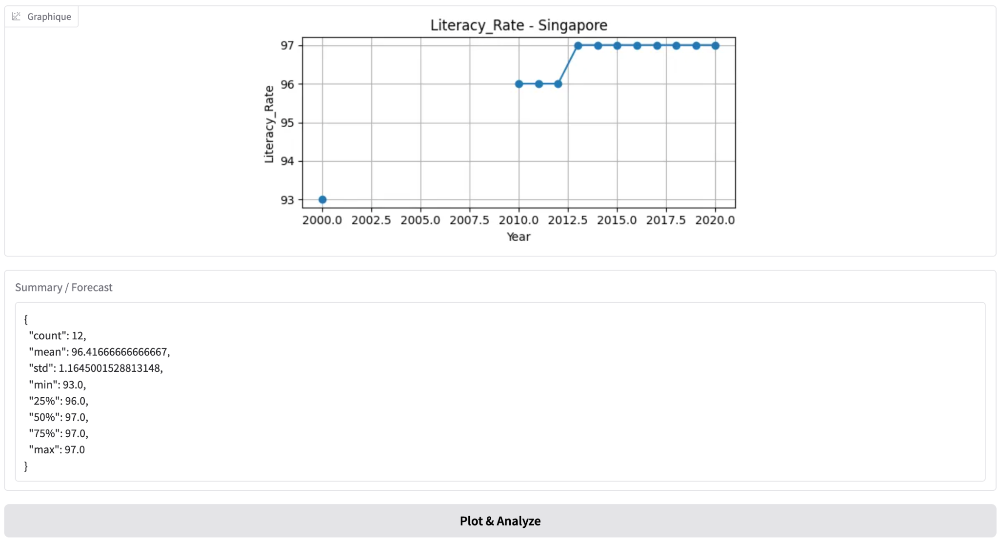

Slide 19
Statistical Summary:
Count: 12 (number of years recorded)
Mean: 96.42 (average literacy rate)
Standard Deviation: 1.16 (small variation, values are stable)
Minimum: 93.0 (lowest recorded value in 2000)
25th Percentile: 96.0 (25% of values are equal to or below 96%)
Median (50th Percentile): 97.0 (half of the values are equal to or below 97%)
75th Percentile: 97.0 (75% of values are equal to or below 97%)
Maximum: 97.0 (highest recorded value)

